Slide 1

Library Management System

Slide 2
About me
I have a background in Electronics and Communication Engineering, holding a Bachelor's degree from East Point College of Engineering and Technology, Bangalore.
I want to learn Data Science because it is a rapidly growing field that combines the power of data with the latest technologies to solve real-world problems and drive innovation.
As a fresher, I am keen to explore good opportunities to grow and contribute in the field of Data Science.
My LinkedIn and GitHub profile URLs
LinkedIn: www.linkedin.com/in/rajiv-roy-chowdary-pudota
GitHub: https://github.com/roychowdary1597

Slide 3
Agenda
Objective of the Project
ER Diagram and schema explanation
Key analysis questions (use cases)
SQL query results with screenshots or summaries
Final business insights and recommendations
Conclusion (Key finding overall)
Q&A
Your Experience/Challenges working on SQL – Data Analysis Project.

Slide 4
Objective Of The Project
Library Inventory Management - For Tracking and Analysing Copies of books and optimal distribution to each branches
Loan & Borrower Insights - Identifying Borrowing Trends and Frequently borrowed books and analyzing borrower activity to enhance library services
Resource Optimization - Preventing Book Shortages and preventing Overstockages and improving accessibility
Data-Driven Decision Making - Improving resource Planning to match demand Trends

Slide 5
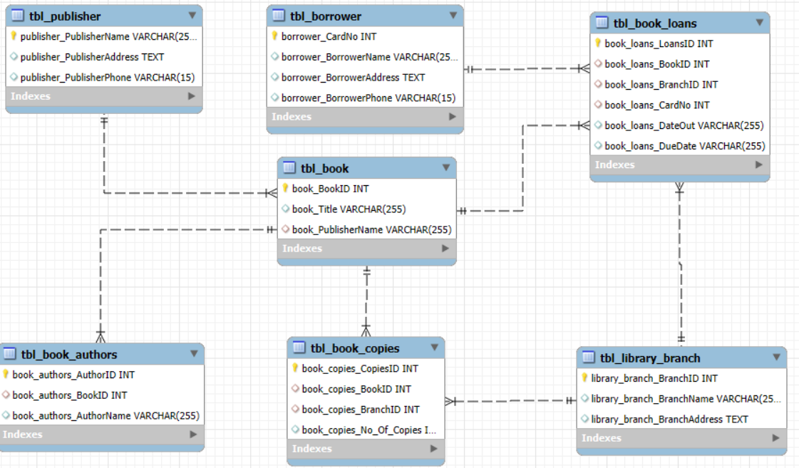
EER Diagram and Schemas Explanation

Slide 6
Key Analysis Questions
How many copies of the book titled "The Lost Tribe" are owned by the library branch whose name is "Sharpstown"?
How many copies of the book titled "The Lost Tribe" are owned by each library branch?
Retrieve the names of all borrowers who do not have any books checked out.
For each book that is loaned out from the "Sharpstown" branch and whose Due Date is 2/3/18, retrieve the book title, the borrower's name, and the borrower's address.
For each library branch, retrieve the branch name and the total number of books loaned out from that branch.
Retrieve the names, addresses, and number of books checked out for all borrowers who have more than five books checked out.
For each book authored by "Stephen King", retrieve the title and the number of copies owned by the library branch whose name is "Central".

Slide 7
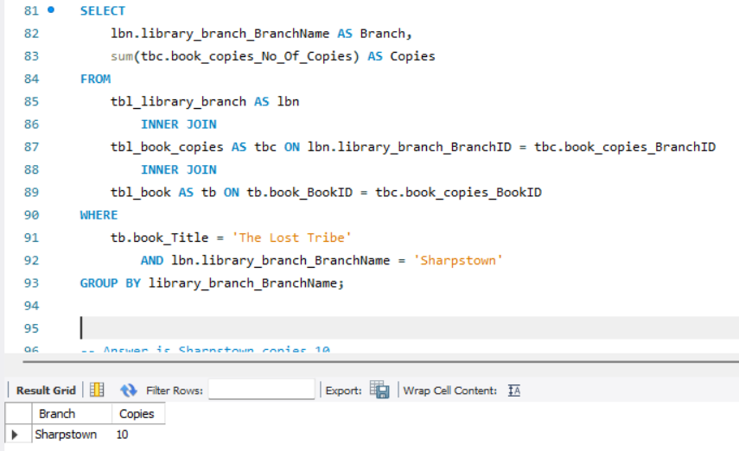
How many copies of the book titled "The Lost Tribe" are owned by the library branch whose name is "Sharpstown"?
This query retrieves the total number of copies of the book titled "The Lost Tribe" that are available at the Sharpstown library branch.

Slide 8
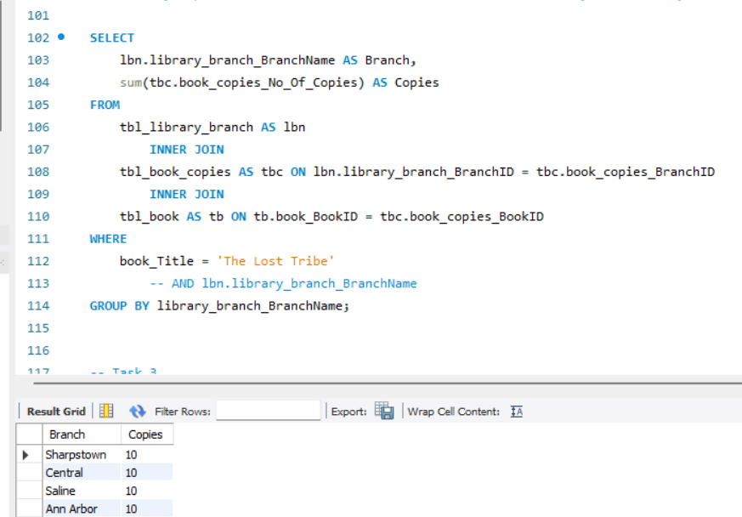
How many copies of the book titled "The Lost Tribe" are owned by each library branch?
Retrieves the total number of copies of the book titled "The Lost Tribe" for each library branch, not just Sharpstown.
Groups the results by library_branch_BranchName so you get a count per branch.

Slide 9
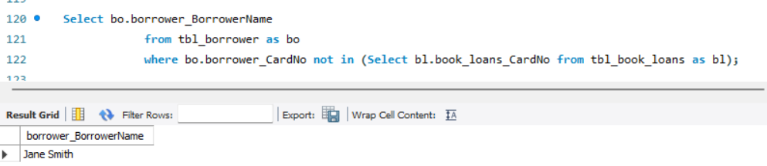
Retrieve the names of all borrowers who do not have any books checked out.
This SQL query retrieves the names of all borrowers who have not borrowed any books.

Slide 10
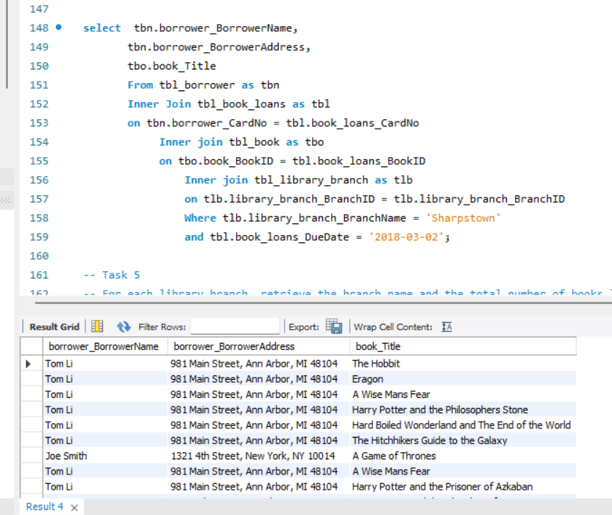
For each book that is loaned out from the "Sharpstown" branch and whose DueDate is 2/3/18, retrieve the book title, the borrower's name, and the borrower's address.
This SQL query retrieves details of borrowers who borrowed books from the Sharpstown library branch with a due date of '2018-03-02'.

Slide 11
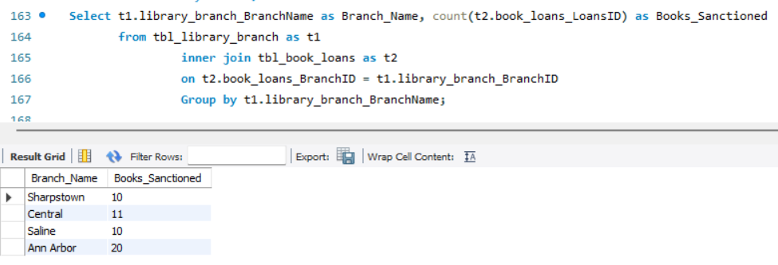
For each library branch, retrieve the branch name and the total number of books loaned out from that branch.
This SQL query retrieves the number of books loaned out (i.e., sanctioned) by each library branch.

Slide 12
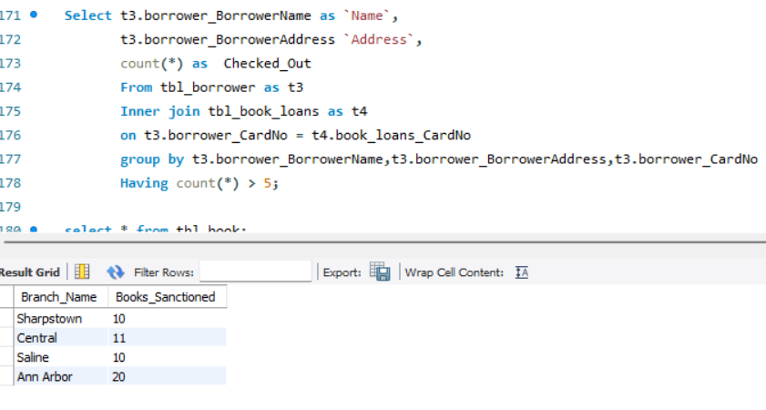
Retrieve the names, addresses, and number of books checked out for all borrowers who have more than five books checked out.
This SQL query retrieves the borrowers who have checked out more than 5 books, along with their name, address, and the total number of books they checked out.

Slide 13
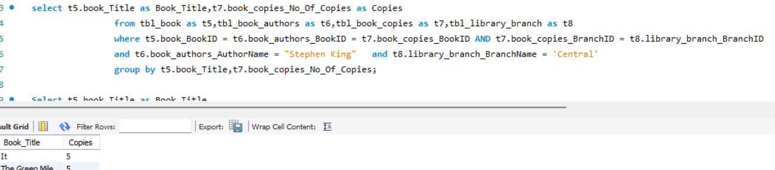
For each book authored by "Stephen King", retrieve the title and the number of copies owned by the library branch whose name is "Central".
The titles of books written by Stephen King
The number of copies of those books
Specifically available at the Central library branch

Slide 14
Final Business insights and Recommendations
Optimized Inventory Allocation – Ensure books are distributed efficiently across branches based on demand patterns.
Enhanced Borrowing Experience – Implement real-time tracking and reservation systems for better accessibility.
Data-Driven Decision Making – Use historical loan data to guide acquisitions and stock adjustments.
Operational Efficiency – Automate book transfers and integrate SQL-based tracking for streamlined management.

Slide 15
Conclusion
The analysis of the library database provides valuable insights into book inventory management, borrower behavior, and operational efficiency.
By leveraging data-driven decision-making, libraries can optimize book distribution, enhance the borrowing experience, and streamline resource allocation.
Implementing automation and predictive analytics will further improve efficiency and ensure that popular books are readily available.
This project highlights the importance of structured data analysis in creating a well-managed library system that meets user needs while maximizing resources.

Slide 16
Q&A
What role Does SQL play in this project?
SQL enables efficient querying, filtering, and aggregation of data for analysis and decision-making.
How Does Library database help book optimize Distribution?
It provides insights into book availability and borrower trends, allowing better inventory management.

Slide 17
Challenges Working on SQL
Understanding table relationships and applying correct joins.
Ensuring data consistency with foreign key constraints.
Handling aggregation across joined tables.
Extracting time-based trends from date data (especially if in VARCHAR format).

Slide 18

THANK YOU

